Slide 1

Dynamic Class Routine and Bus Scheduler
Submitted By-
Ekthiar Uddin– 220238142 Faiyaz Bin Jahangir– 220238112 Md Lokman Huda Hriday– 220238135 Ismail Hosen– 220238127 Md Zahed Hossain– 220238125 Semester - 5th Section - C
Submitted To-
Ferdous Ara
Assistant Professor
Department of CSE
BGC Trust University Bangladesh

Slide 2

Dynamic Class Routine and Bus Scheduler
This system will provide a flexible class schedule and real-time updates on bus arrivals and departures to help students seamlessly navigate their day.

Slide 3



Motivational
Driven by Passion
Collaborative Spirit
Thriving on Challenges
A strong drive to create innovative solutions that make a real difference.
Fostering a culture of teamwork and shared knowledge to achieve greater impact.
Motivated by the opportunity to tackle complex technical problems and push the boundaries of what's possible.

Slide 4




Contribution
Dedicated Effort
Collaborative Approach
Ongoing Improvement
The development team will contribute their expertise and passion to create a dynamic, user-friendly application that seamlessly integrates class schedules, bus routes, and real-time updates.
The team will work closely with stakeholders to gather feedback, identify pain points, and craft innovative solutions that meet the evolving needs of students and faculty.
The application will be continuously refined and enhanced based on user insights, ensuring it remains a valuable and indispensable tool for the campus community.

Slide 5

Approach
1
Planning
Gather requirements, define scope, and create a project roadmap.
2
Design
Architect the system and develop wireframes and mockups.
3
Implementation
Code the frontend and backend components using agile methodology.

Slide 6
Conceptual Model
Student
Class
Bus
Able to view their class schedule, bus timetables, and receive real-time updates.
Flexible scheduling that can adapt to changes in the academic calendar.
Tracking of bus arrivals and departures to help students plan their commute.

Slide 7
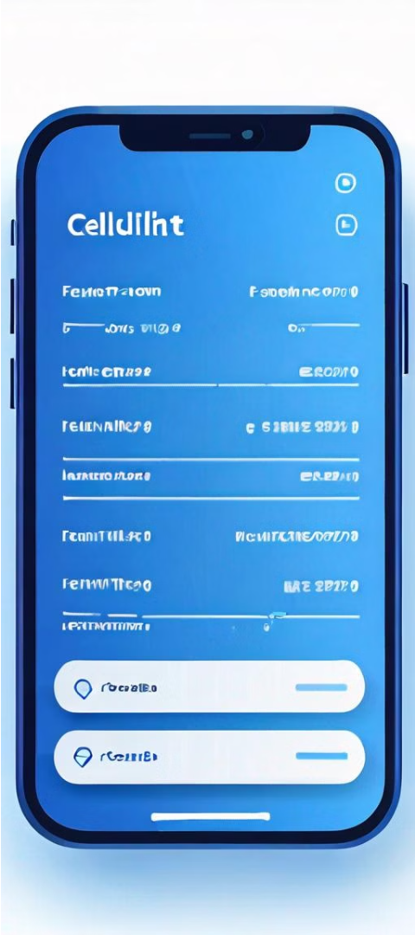
Requirements
1
Functional
2
Non-Functional
View class schedule, real-time bus updates, and receive notifications.
Scalable, user-friendly, and secure with data privacy.

Slide 8
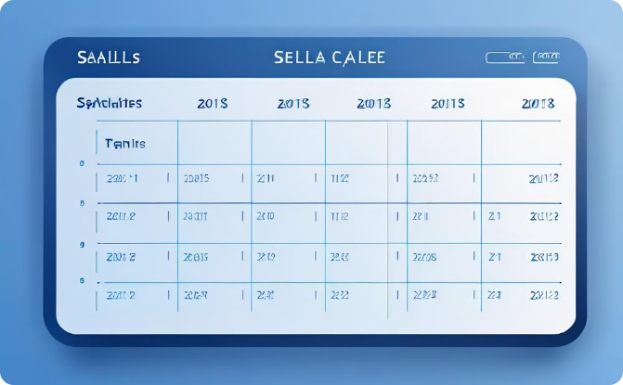
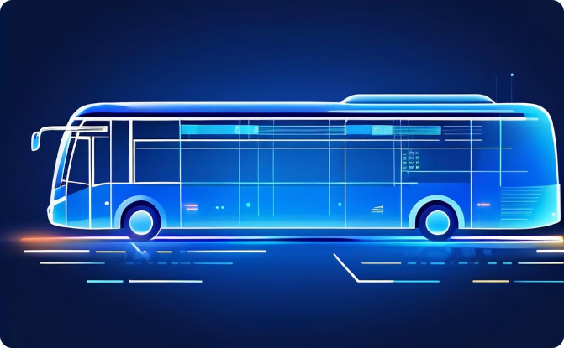
Wireframes
Class Schedule
Bus Tracker
Students can view their daily and weekly class schedules.
Real-time updates on bus locations and estimated arrival times.

Slide 9
Mockup
Intuitive Interface
Responsive Design
The app will have a clean, user-friendly design to enhance the student experience.
The app will be optimized for both desktop and mobile devices.
Personalized Experience
Real-time Updates
Students can customize the app to their preferences and schedules.
Instant notifications on class changes and bus arrival/departure times.

Slide 10




Technology Stack
HTML
PHP
MySQL
CSS
For building the responsive and interactive user interface.
Powering the backend server and API endpoints.
Storing and managing the class and bus schedule data.
Enabling cross-platform mobile app development.

Slide 11
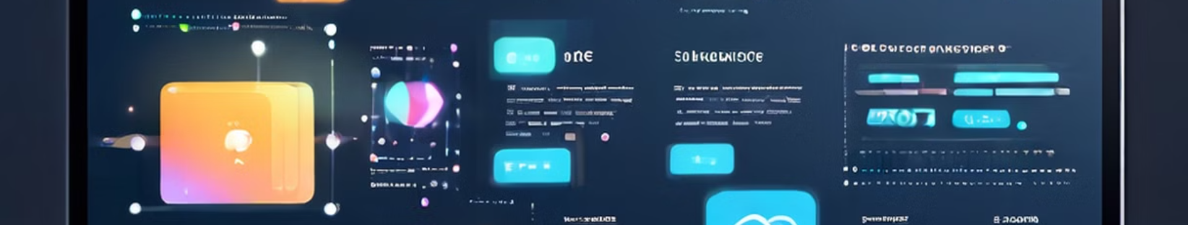
Frontend and Backend Language
Frontend Language
Backend Language
Integrating Front and Back
HTML, CSS for rich dynamic web interactions
Node.js, Python, Java for scalable server-side logic
APIs, webhooks, and event-driven architecture for seamless flow

Slide 12



Sign In
Or use your account
Hello, Friend!
Enter your details and start journey with us
Name
Student ID
SIGN IN
SIGUP

Slide 13
Create Account
Or use your email for registration
Welcome Back!
To keep connected with us please login with your personal info
Name
Student ID
Department
SIGN IN
Semester
Section
SIGNUP

Slide 14


USER NAME Sign out
Monday
Feb 12,24
09:30–10:20 | 10:25-11:15 | 11:20-12:10 | 12:15-01:05 | 01:10-02:00 | 02:05-02:55
MP (SRM) – 215 | SAD (FA) - 223 | MP LAB (SRM) – 126 |  | DC (TS) – 223
MP(SRM)-223 |  | SAD(FA)-126 | OS(MB) -233 | DBMS(MUE) - 233
OS(MB)-118 | OS LAB(BRC) -121 | OS(MB) – 233 | BLL (AB) -228 |  | SAD (FA) -221
SDP-1 (FA)-221 |  | DBMS(MUE) – 215 | DC (TS)-131 | DBMS LAB (MUE)- 118
TRANSPORTS
CHANDGAON
OXYGEN
GEC
AGRABAD
New MARKET
KAPTAI Rastar MATHA

Slide 15




Conclusion
Streamlined Experience
The app will provide students with a seamless and efficient way to manage their academic and transportation needs.
Improved Planning
Real-time updates and personalized schedules will help students better plan their day and commute.
Enhanced Convenience
Students will have all the information they need at their fingertips, reducing stress and improving their overall academic experience.

